Slide 1
RENT-A VILLA
Radhika Shroff
Vega Shetty
Priyanka SIngh

Slide 2
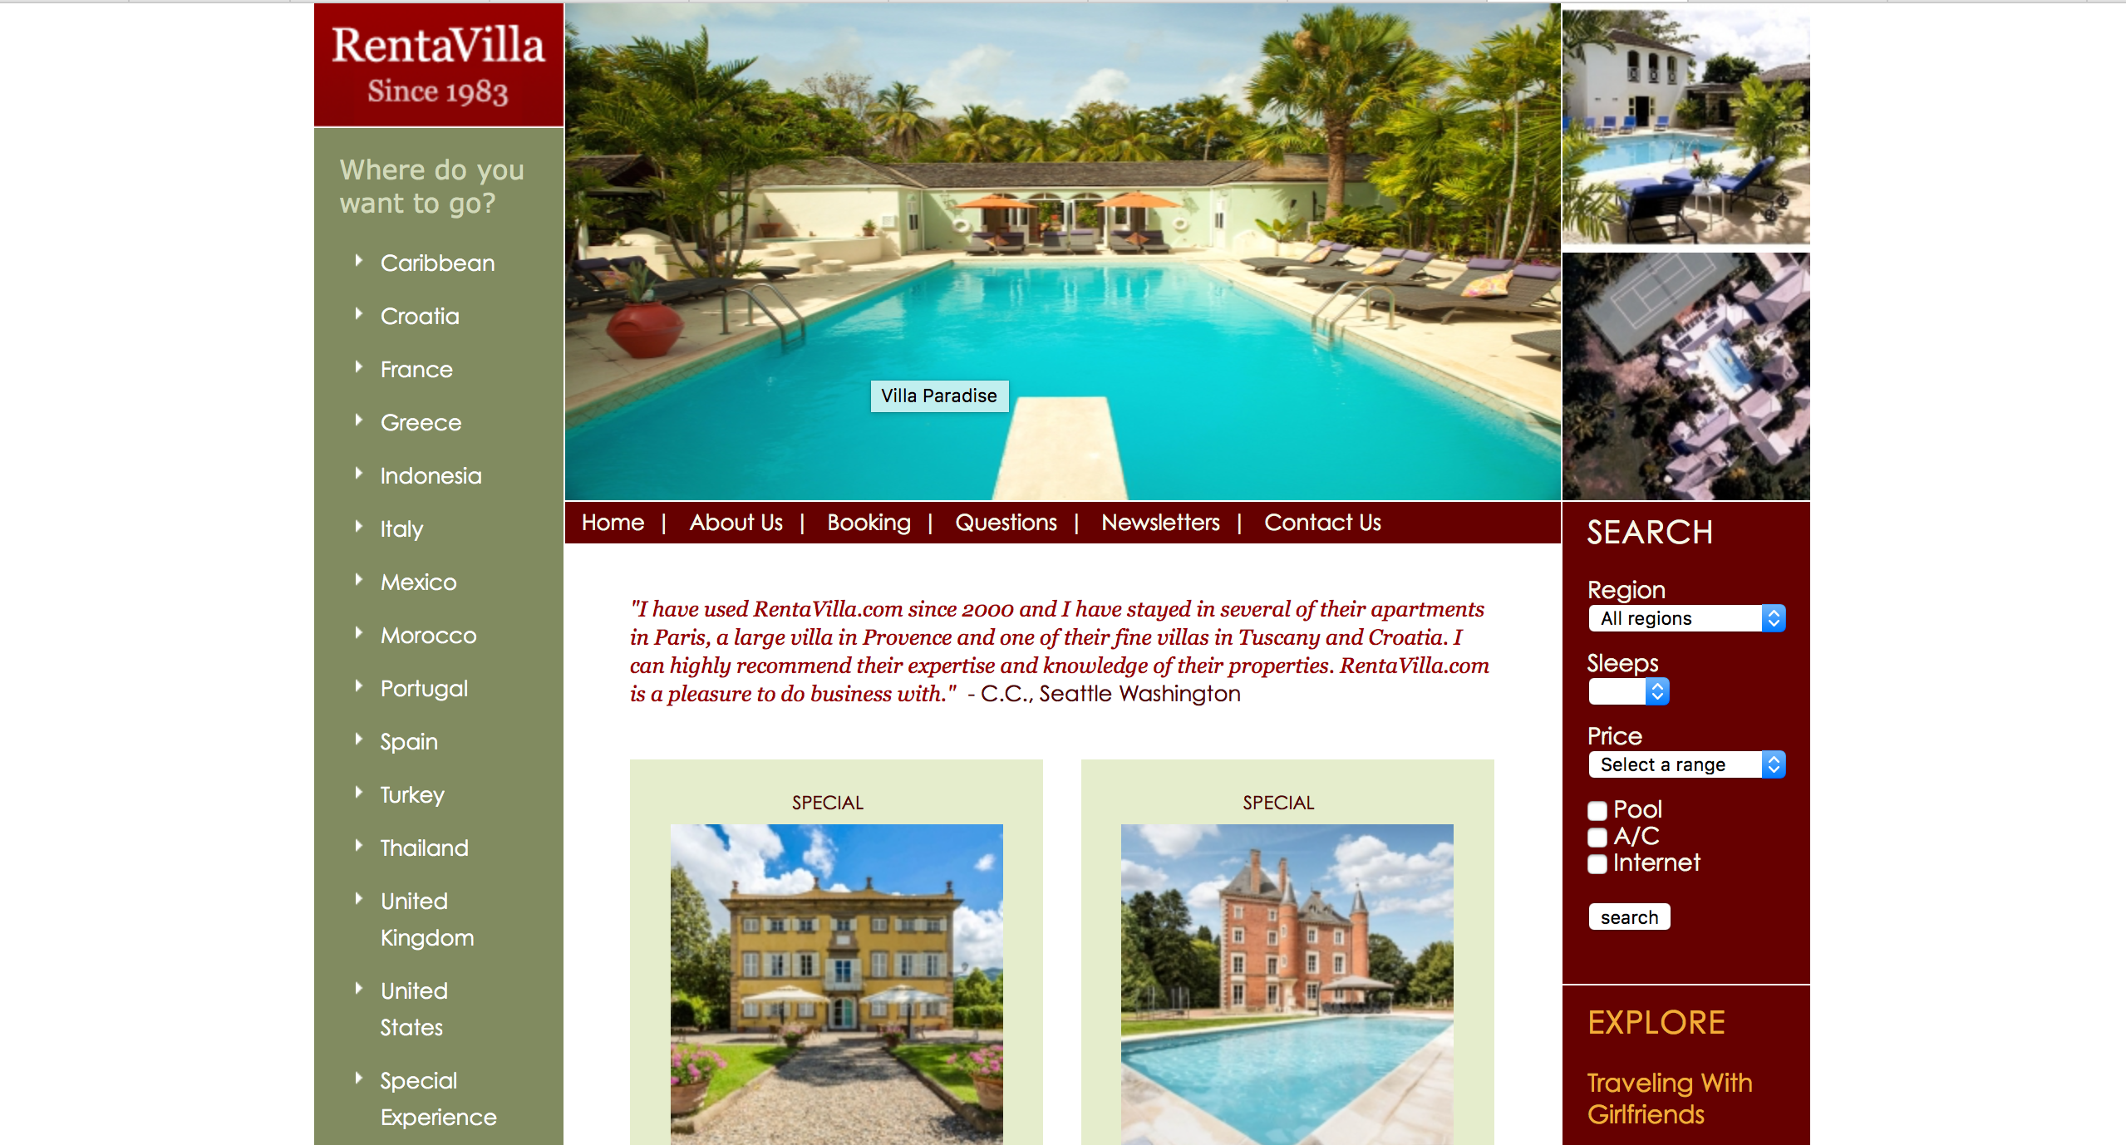
About RENT-A-VILLA
It offers luxury holiday villas, houses, farmhouses and apartments around the world.
User’s can reserve villas according to their location and price preferences.

Slide 3
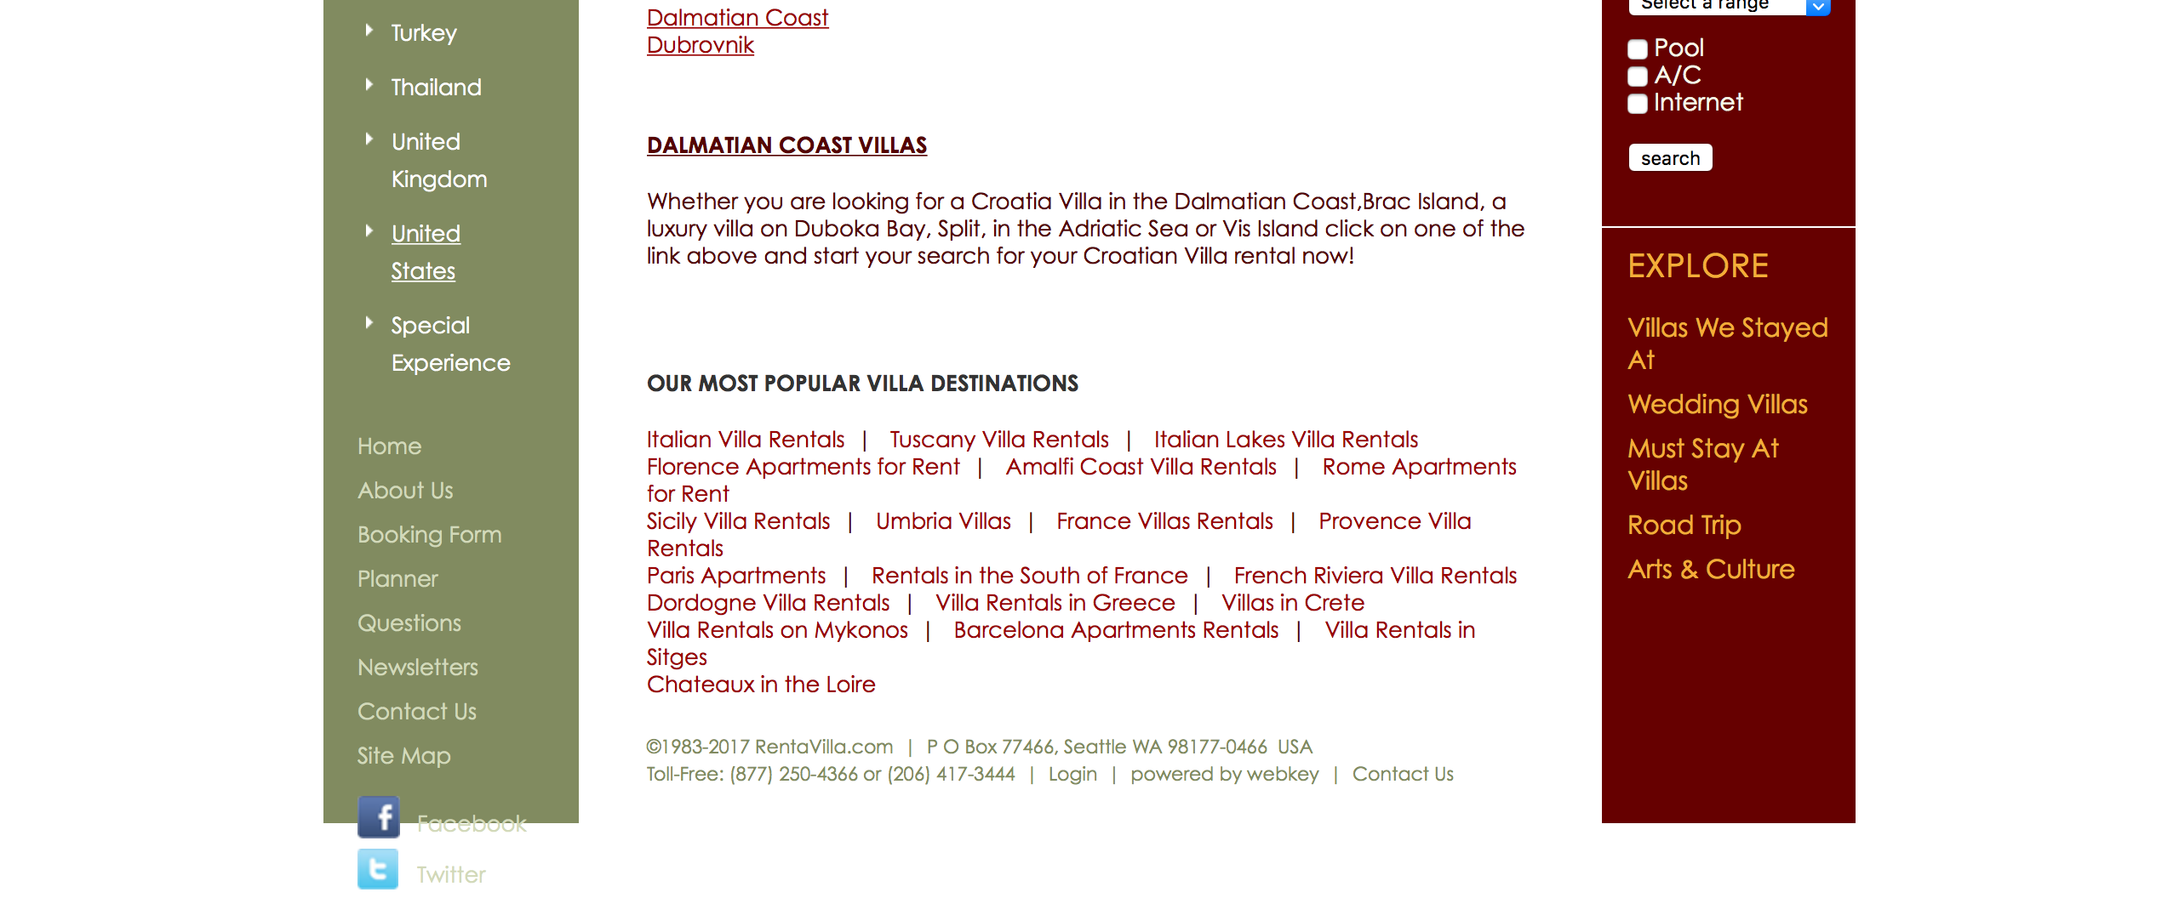
Improvements
The overall website is not responsive.
The elements of the website are not aligned properly.

Slide 4
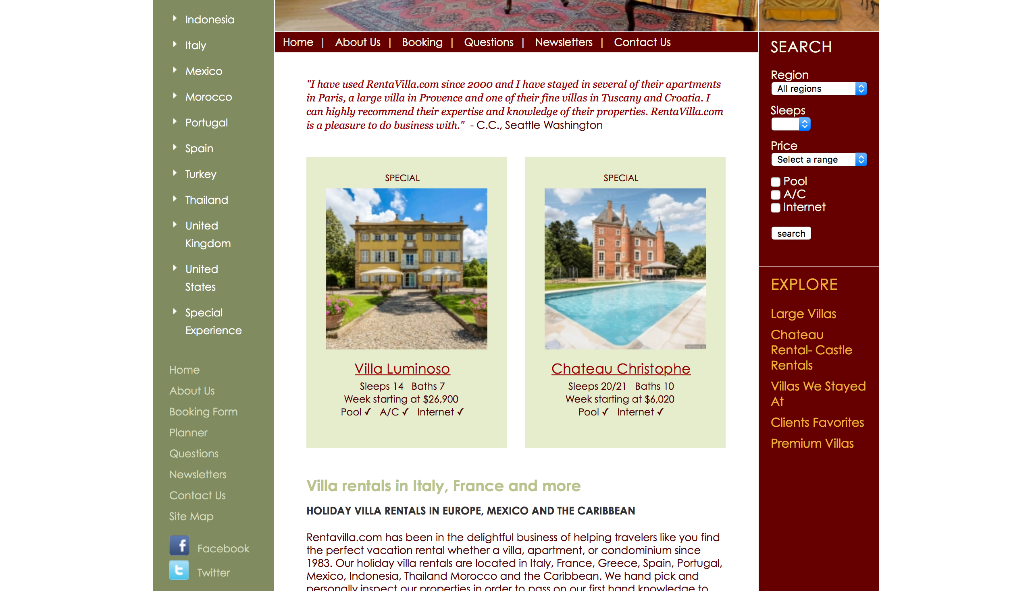
There is repetitive menu bar on the left side and on the top .
It lacks basic functionalities like signup and login.
It lacks communication method like instant messaging.

Slide 5
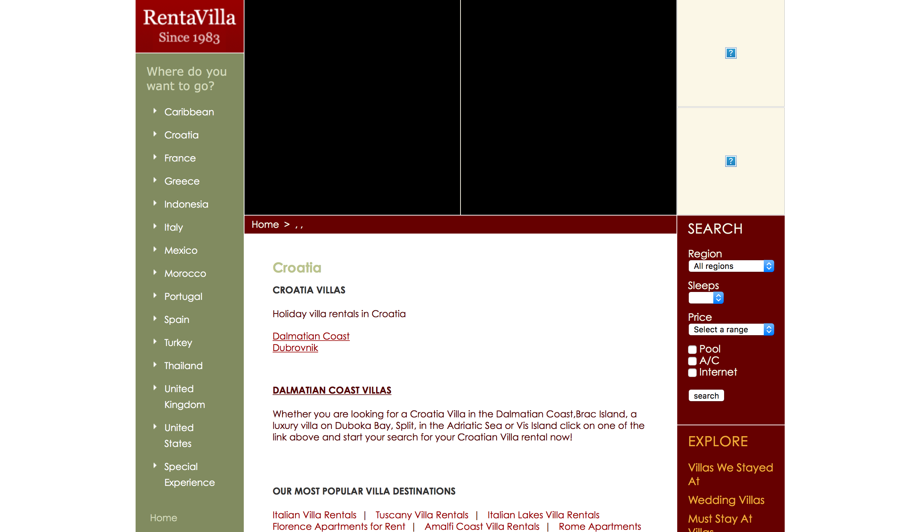
Some pages are not updated.
It leaves user’s with disappointment as user cannot see the images requested for.

Slide 6
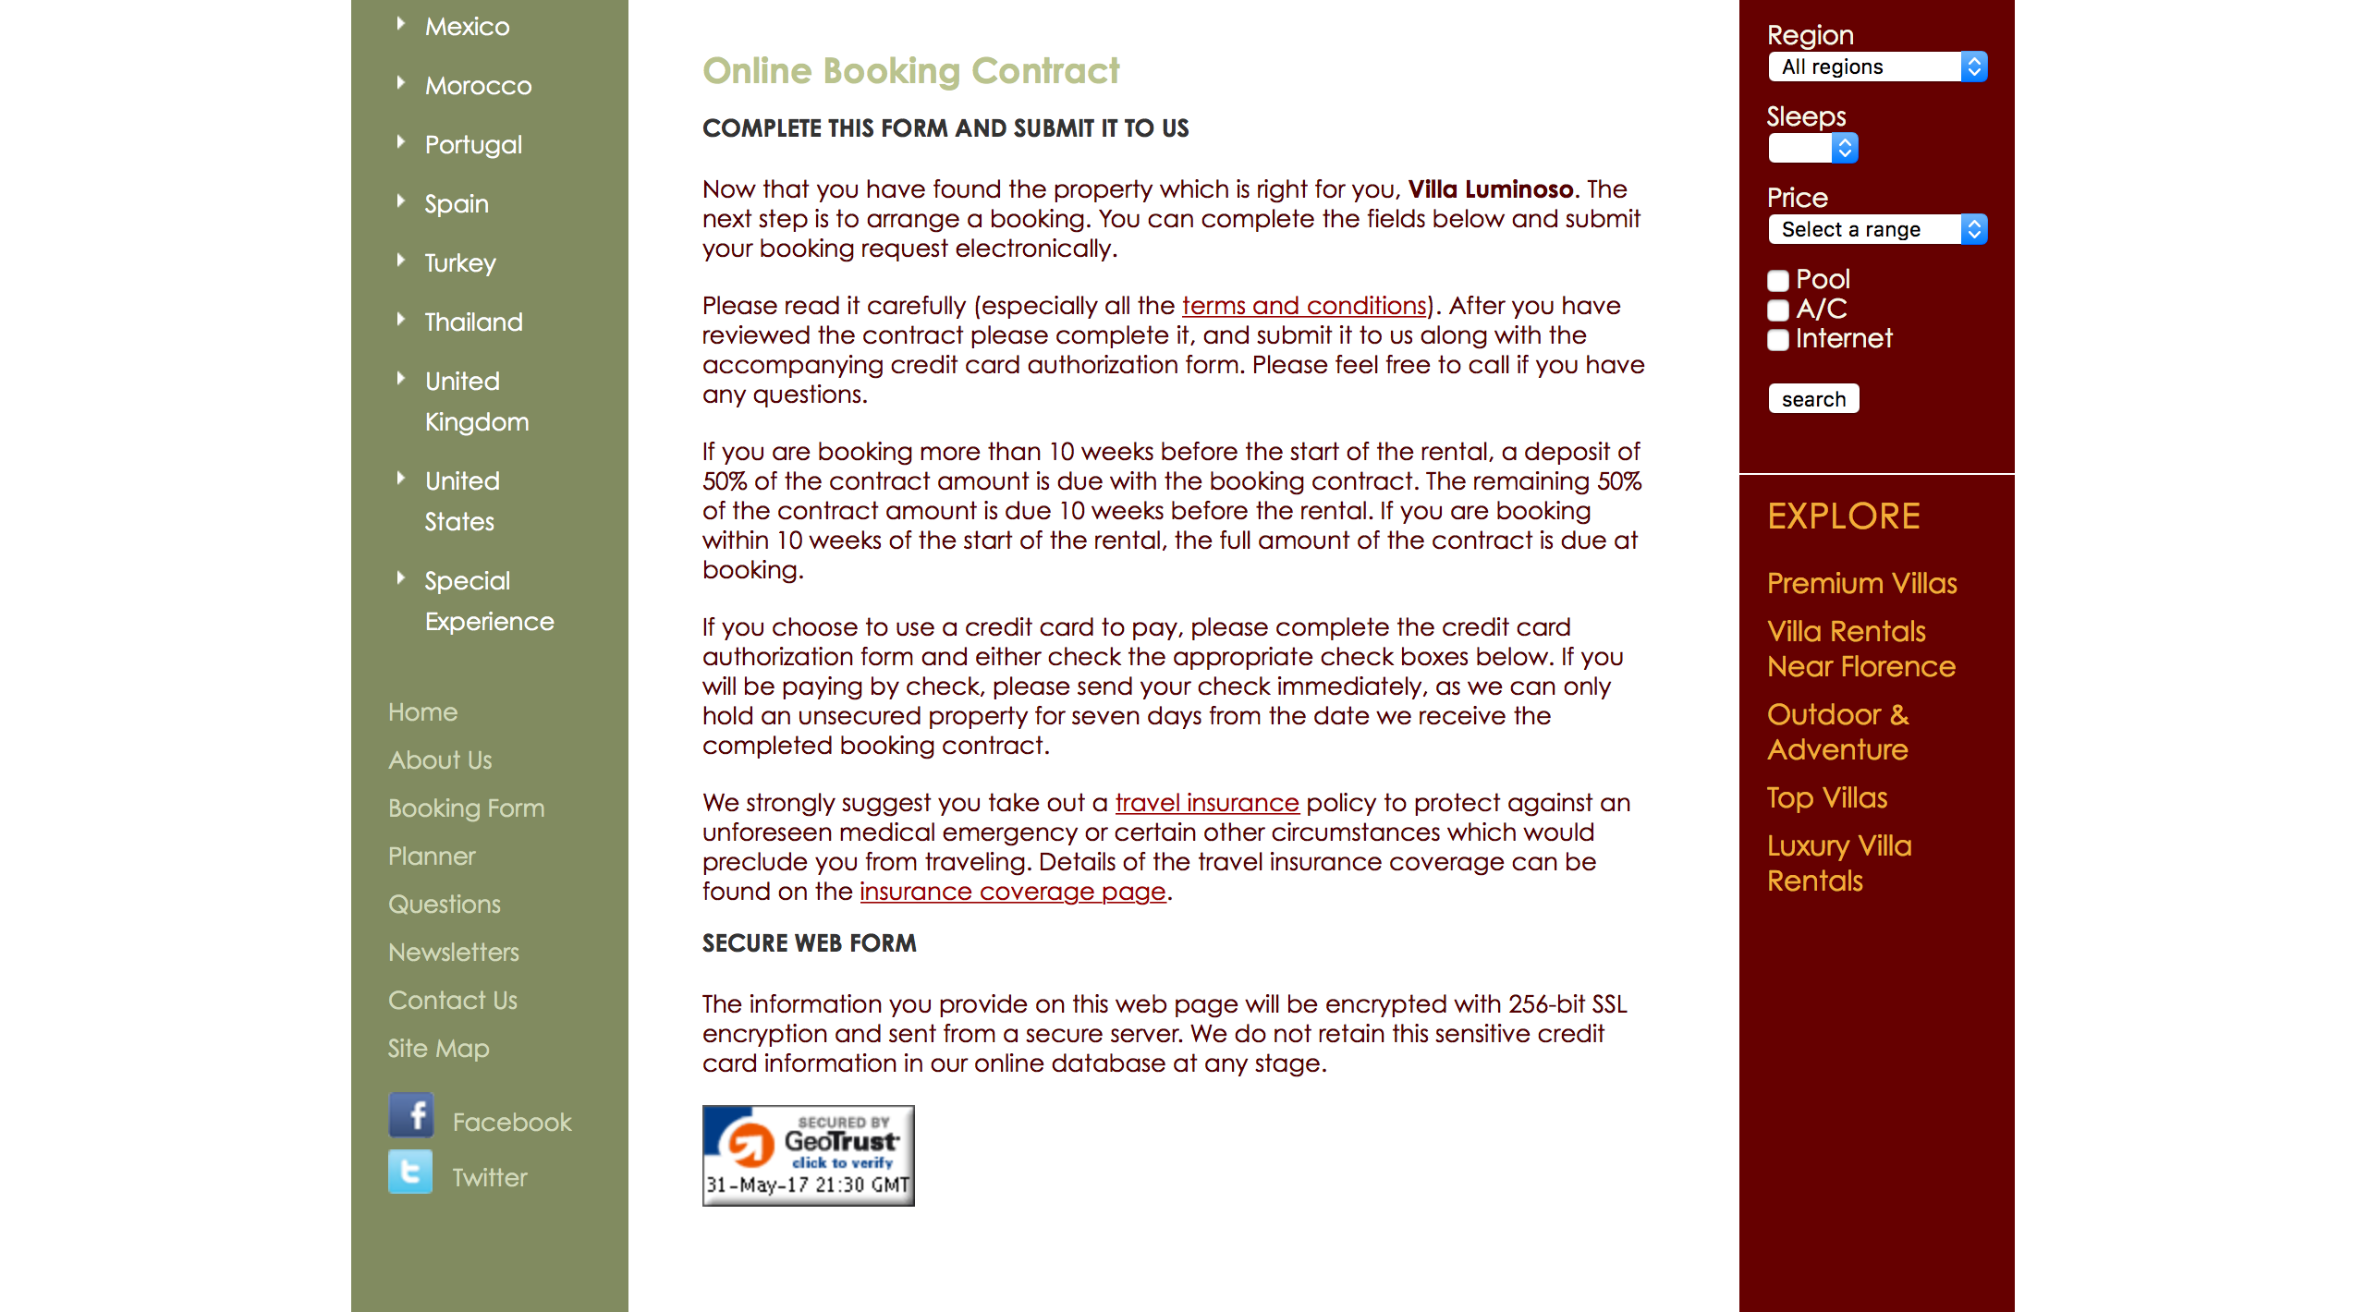
Payment process is not user-friendly and reliable.
There are also very less filters that do not allow the user’s with much options.
It also lacks general validations for user input.

Slide 7
Thank You

